Slide 1

Machine Learning Algorithm

Slide 2

Learning Overview
At the end of this lesson
Understand Machine learning in its simplest form
Different types of machine learning and to be able identify the machine learning to be used for different task.
Machine learning use cases

Slide 3
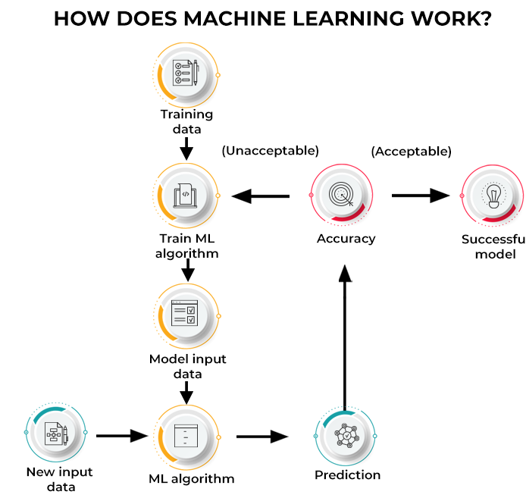
What is machine learning
Machine learning (ML) is a discipline of artificial intelligence (AI) that provides machines with the ability to automatically learn from data and past experiences while identifying patterns to make predictions with minimal human intervention.
Machine learning methods enable computers to operate autonomously without explicit programming. ML applications are fed with new data, and they can independently learn, grow, develop, and adapt
Machine learning derives insightful information from large volumes of data by leveraging algorithms to identify patterns and learn in an iterative process. ML algorithms use computation methods to learn directly from data instead of relying on any predetermined equation that may serve as a model.
How does ML work?
Machine learning algorithms are molded on a training dataset to create a model. As new input data is introduced to the trained ML algorithm, it uses the developed model to make a prediction. Further, the prediction is checked for accuracy. Based on its accuracy, the ML algorithm is either deployed or trained repeatedly with an augmented training dataset until the desired accuracy is achieved.

Slide 4
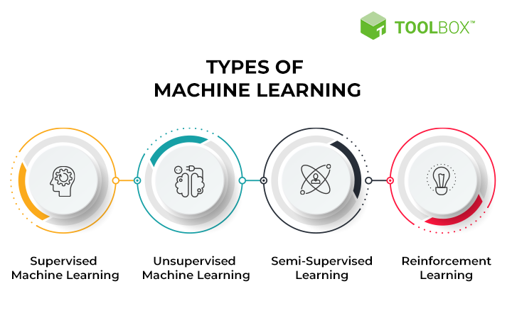
Types of machine learning
This type of ML involves supervision, where machines are trained on labeled datasets and enabled to predict outputs based on the provided training.
Unsupervised learning refers to a learning technique that’s devoid of supervision. Here, the machine is trained using an unlabeled dataset and is enabled to predict the output without any supervision.
Reinforcement learning is a feedback-based process. Here, the AI component automatically takes stock of its surroundings by the hit & trial method, takes action, learns from experiences, and improves performance.
Semi-supervised learning comprises characteristics of both supervised and unsupervised machine learning.

Slide 5
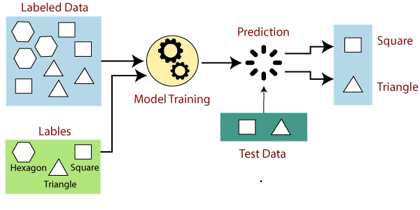
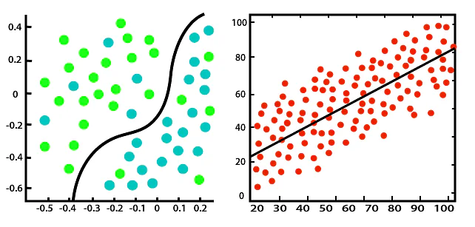
Most common Machine Learning models
Supervised Machine Learning
Supervised ML
For Supervised, consider an input dataset of parrot and crow images. Initially, the machine is trained to understand the pictures, including the parrot and crow’s color, eyes, shape, and size. Post-training, an input picture of a parrot is provided, and the machine is expected to identify the object and predict the output. The trained machine checks for the various features of the object, such as color, eyes, shape, etc., in the input picture, to make a final prediction. This is the process of object identification in supervised machine learning.,
The primary objective of the supervised learning technique is to map the input variable (a) with the output variable (b). Supervised machine learning is further classified into two broad categories
Classification and Regression Supervised ML
Classification: These refer to algorithms that address classification problems where the output variable is categorical; for example, yes or no, true or false, male or female, etc. Real-world applications of this category are evident in spam detection and email filtering. Some known classification algorithms include the Random Forest Algorithm, Decision Tree Algorithm, Logistic Regression Algorithm, and Support Vector Machine Algorithm.
Regression: Regression algorithms handle regression problems where input and output variables have a linear relationship. These are known to predict continuous output variables. Examples include weather prediction, market trend analysis, etc. Popular regression algorithms include the Simple Linear Regression Algorithm, Multivariate Regression Algorithm, Decision Tree Algorithm, and Lasso Regression

Slide 6
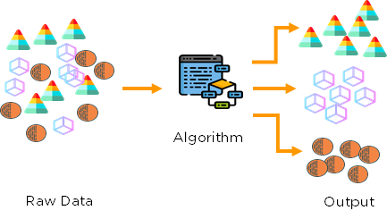
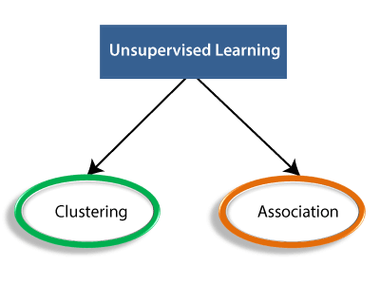
Most common Machine Learning models
Unsupervised Machine Learning
Unsupervised ML
For Unsupervised, consider an input dataset of images of a fruit-filled container. Here, the images are not known to the machine learning model. When we input the dataset into the ML model, the task of the model is to identify the pattern of objects, such as color, shape, or differences seen in the input images and categorize them. Upon categorization, the machine then predicts the output as it gets tested with a test dataset
Unsupervised machine learning is further classified into two types:
Clustering: The clustering technique refers to grouping objects into clusters based on parameters such as similarities or differences between objects. For example, grouping customers by the products they purchase. Some known clustering algorithms include the K-Means Clustering Algorithm, Mean-Shift Algorithm, DBSCAN Algorithm, Principal Component Analysis, and Independent Component Analysis
Association: Association learning refers to identifying typical relations between the variables of a large dataset. It determines the dependency of various data items and maps associated variables. Typical applications include web usage mining and market data analysis. Popular algorithms obeying association rules include the Apriori Algorithm, Eclat Algorithm, and FP-Growth Algorithm
Clustering and Assosciation Unsupervised ML

Slide 7
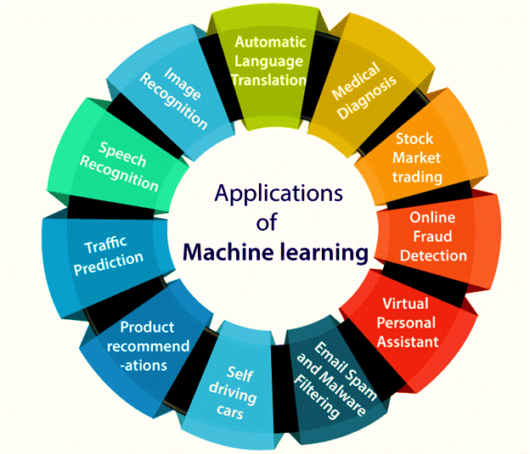
Top Machine learning Applications

Slide 8

Resources
Unsupervised Machine learning
https://www.cac.cornell.edu/education/Training/DataAnalysis/RelationalDatabases.pdf
https://www.projectpro.io/article/classification-vs-regression-in-machine-learning/545
https://www.enjoyalgorithms.com/blogs/classification-and-regression-in-machine-learning

